Slide 1

Python: Logistic regression and k-Nearest Neighbor algorithms
Eduardo Destefani Stefanato¹*
Vitor Souza Premoli Pinto de Oliveira¹*
¹Universidade Federal do Espírito Santo
Artificial Intelligence Applied to Images
Universidade Federal do Espírito Santo
Artificial Intelligence Applied to Images
Deep ANNs applied to images

Slide 2
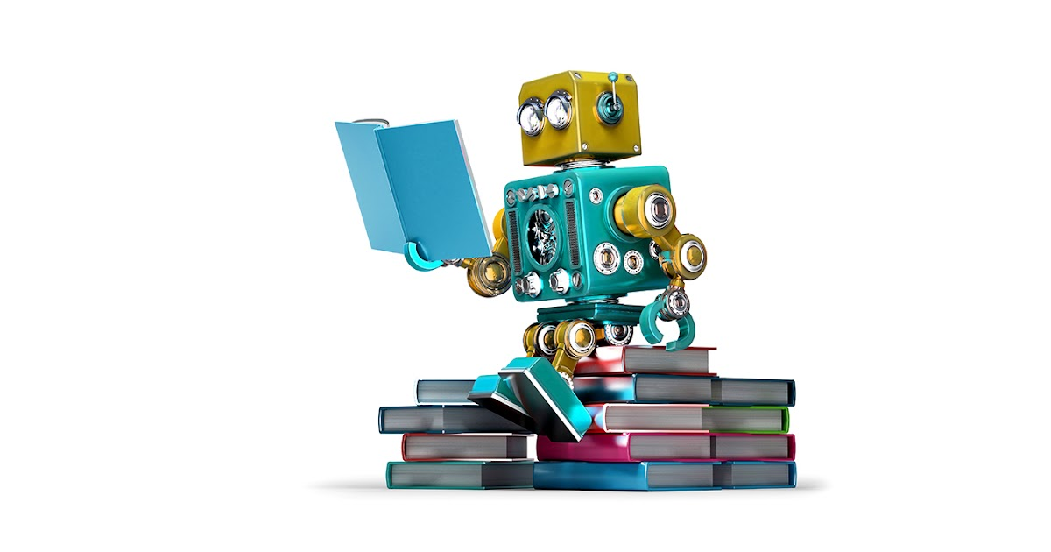
Intoduction
Python
Sumary
Objectives;
Machine learning;
Learning process;
Iris data set application.
Algorithm Classification.
K-Nearest Neighbor (KNN);
Logistic regression.
Cross-validation;
Metrics.
Conclusion;
Cross validate.
References.
Universidade Federal do Espírito Santo
Artificial Intelligence Applied to Images
Deep ANNs applied to images

Slide 3
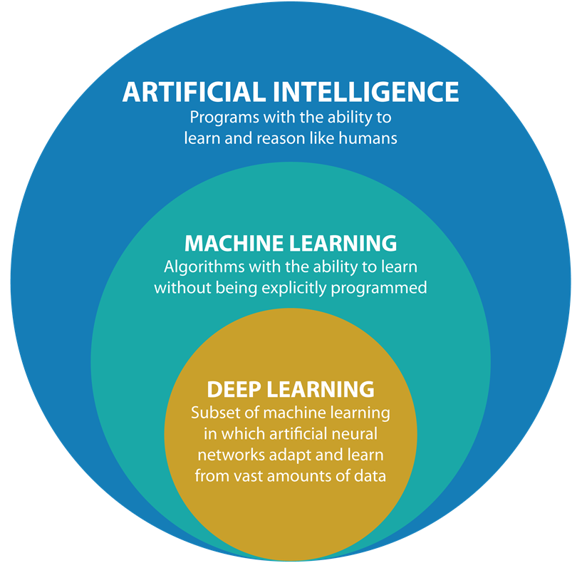
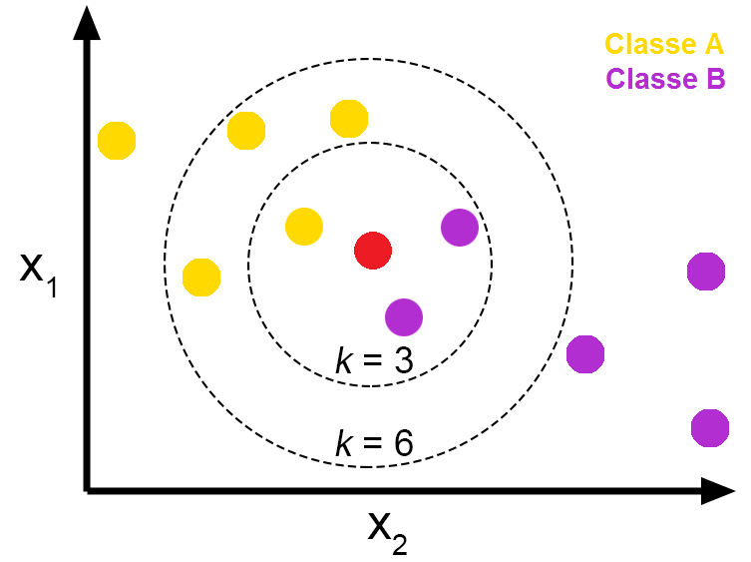
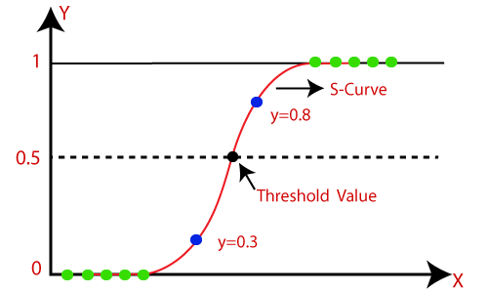
Intoduction
Python
Objectives
Introduce the idea of Machine Learning;
Show the mathematical logic behind two algorithms used in classification (KNN and Logistic regression);
Evaluate (through cross-validation) the two models with different algorithms in different metrics;
After made the evaluation, show which model had better performance in each metric.
Universidade Federal do Espírito Santo
Artificial Intelligence Applied to Images
Deep ANNs applied to images

Slide 4
MACHINE LEARNING
Learning process
Universidade Federal do Espírito Santo
Artificial Intelligence Applied to Images
Deep ANNs applied to images

Slide 5
Machine Learning
Learning process
What’s Machine Learning?
Machine learning is a subfield of artificial intelligence, the study and construction of algorithms that can learn from data and make predictions. The iterative aspect of machine learning is important because as models are exposed to new data, they are able to adapt intelligently.
Machine learning methods
Machine learning elements
For this to happen,
we have to:
Are divided into:
Supervised Learning
Representation
Reinforcement Learning
Unsupervised Learning
Otimization
Evaluation
Universidade Federal do Espírito Santo
Artificial Intelligence Applied to Images
Deep ANNs applied to images

Slide 6

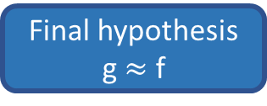
Machine Learning
Learning process
Learning process of Machine Learning
Function target
f: x → y
No model is 100% effective, the algorithm determines based on the cost function which model minimizes the errors
Train data
($x_{1}$, $y_{1}$), ..., ($x_{n}$, $y_{n}$)
Algorithm
Final hypothesis
g $≈$ f
Input
Output
Hypothesis space
Function target
Train data
Model
N possible functions (g) for the algorithm to determine the most efficient one for the model based on the predictor and target variables
Hypothesis
Universidade Federal do Espírito Santo
Artificial Intelligence Applied to Images
Deep ANNs applied to images

Slide 7
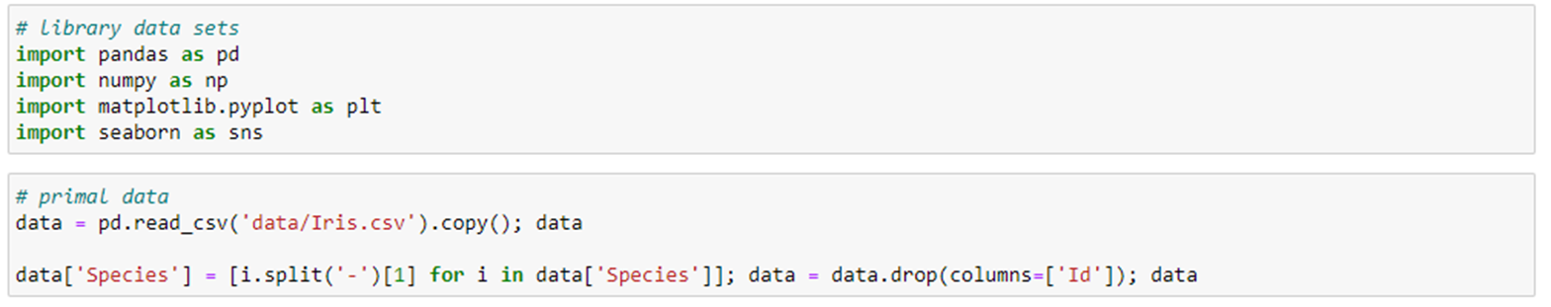
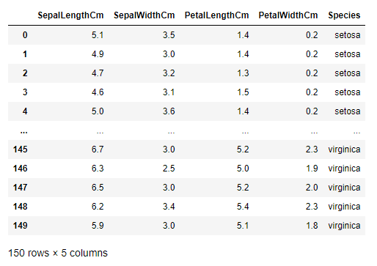
Iris Data Set Application
Learning process
Extracting the dataset
The rows being the samples and the columns being: Sepal length (cm), Sepal width (cm), Petal length (cm) and Petal width (cm).
Universidade Federal do Espírito Santo
Artificial Intelligence Applied to Images
Deep ANNs applied to images

Slide 8
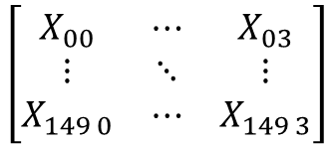
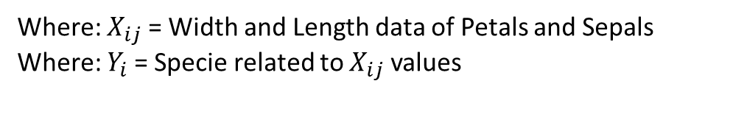
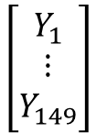
Iris Data Set Application
Learning process
Predictive Model
Input
x
Length and width data of petals and sepals
Output
y
Decision→ Iris-setosa, Iris-virginica or Iris-versicolor
Function Target
F = x→ y
{Species profiles}
{Unknown mathematical function}
$$\left[\begin{matrix}X_{00} & ⋯ & X_{03} \\ ⋮ & ⋱ & ⋮ \\ X_{149 0} & ⋯ & X_{149 3}\end{matrix}\right]$$
$$\left[\begin{aligned}Y_{1} \\ ⋮ \\ Y_{149}\end{aligned}\right]$$
Where: $X_{ij}$= Width and Length data of Petals and Sepals
Where: $Y_{i}$= Specie related to $X_{ij}$ values
Train Data
Hypothesis
G = x→ y
Function to be discovered by the algorithm
Universidade Federal do Espírito Santo
Artificial Intelligence Applied to Images
Deep ANNs applied to images

Slide 9
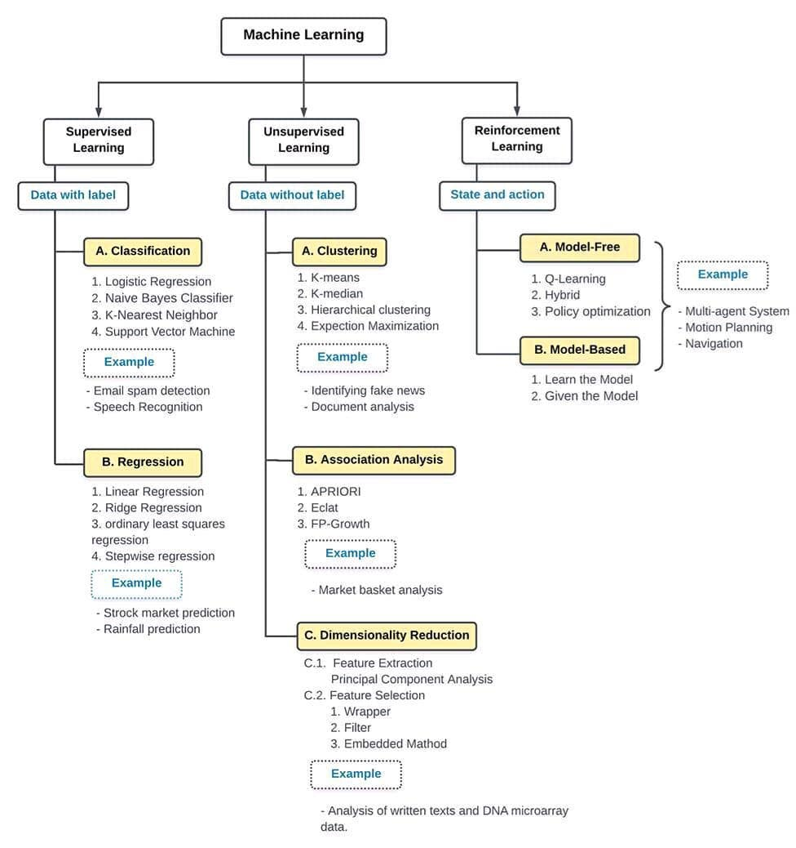
Machine Learning
Algorithms Classification
Supervised Learning: Algorithms Classification
K-Nearest Neighbor → is a instance-based algorithm
Logistic Regression → is a regression algorithm
Universidade Federal do Espírito Santo
Artificial Intelligence Applied to Images
Deep ANNs applied to images

Slide 10
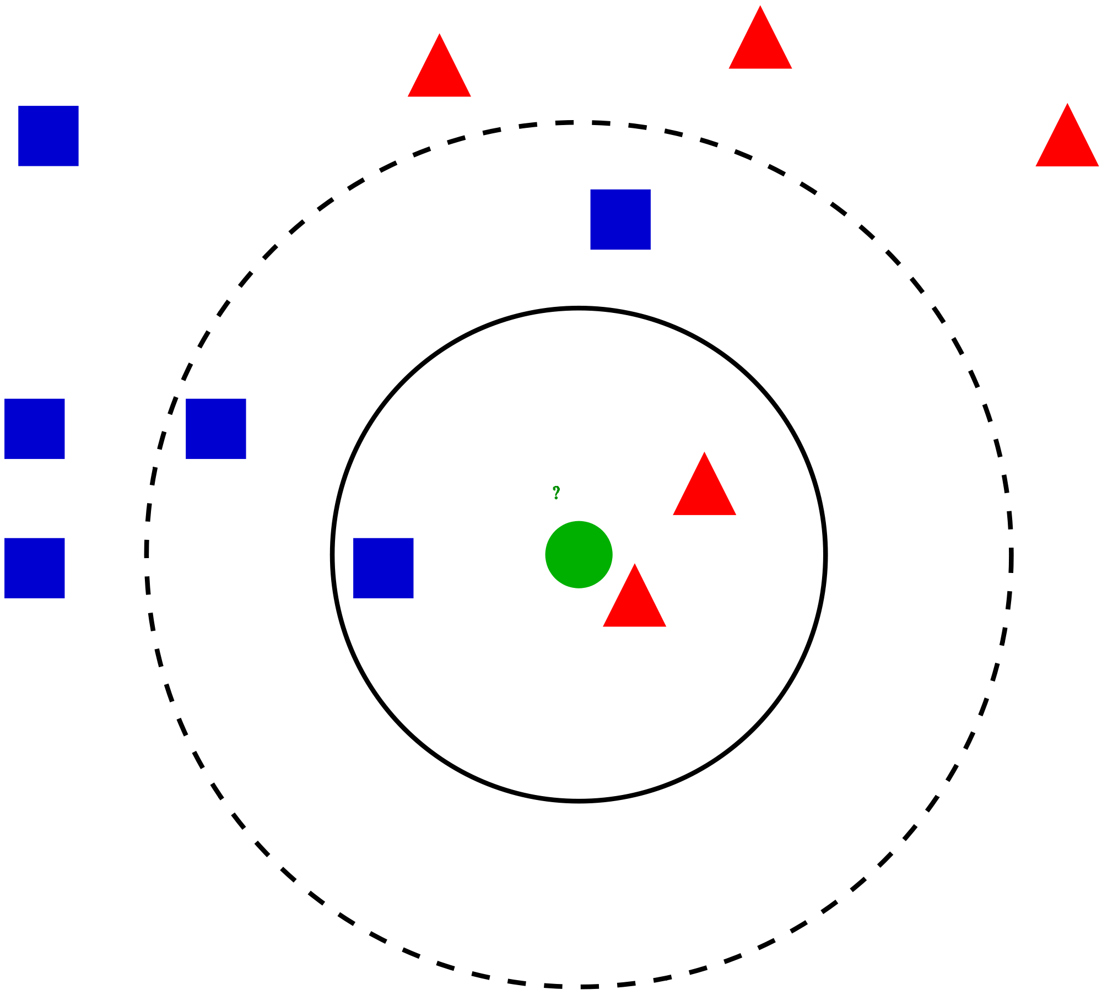



Machine Learning
Algorithms Classification
K-NN (K-Nearest Neighbor)
Similarity is defined according to a distance metric between two data points. The k-nearest-neighbor classifier is commonly based on the Euclidean distance between a test sample and the specified training samples.
$$X_{2}$$
$$d(X_{i}^{},X_{l}^{})=\sqrt{{(X_{i1}^{}−X_{l1}^{})}^{2}+…+{(X_{ip}^{}−X_{lp}^{})}^{2}}$$
Where:
i = numbers data;
p = n features (dimensions).
K = 1
K = 2
$$X_{1}$$
Universidade Federal do Espírito Santo
Artificial Intelligence Applied to Images
Deep ANNs applied to images

Slide 11
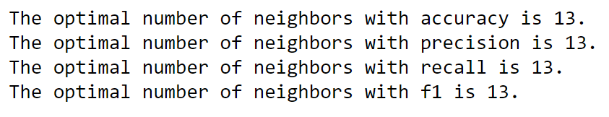
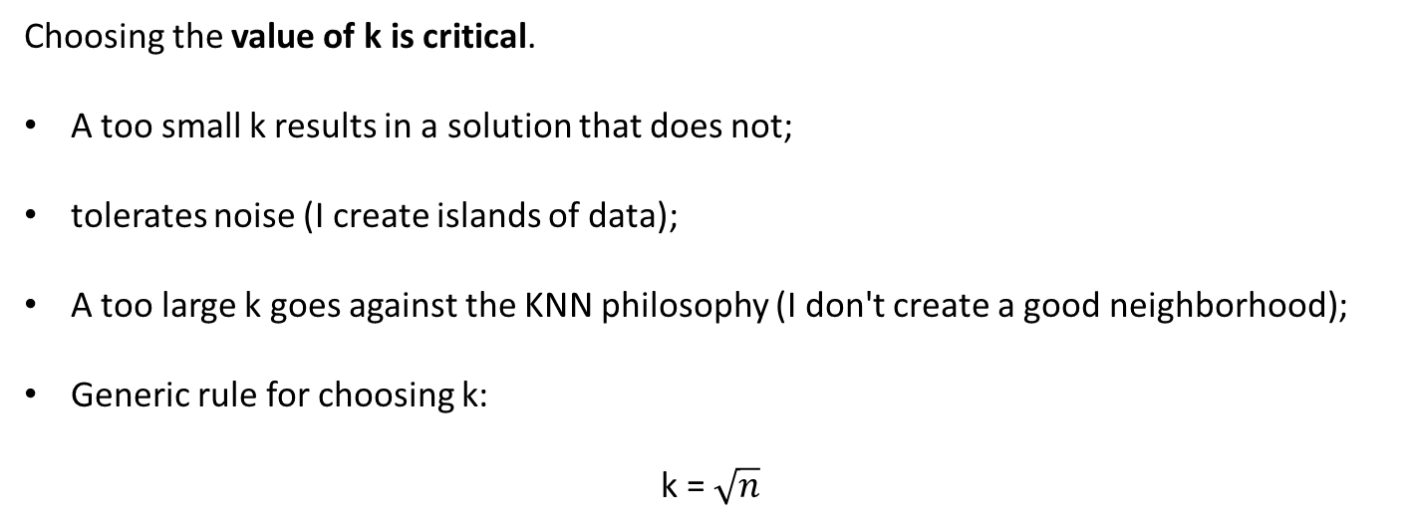
Machine Learning
Algorithms Classification
K-NN (K-Nearest Neighbor)
Choosing the value of k is critical.
A too small k results in a solution that does not;
tolerates noise (I create islands of data);
A too large k goes against the KNN philosophy (I don't create a good neighborhood);
Generic rule for choosing k:
k = $\sqrt{n}$
Universidade Federal do Espírito Santo
Artificial Intelligence Applied to Images
Deep ANNs applied to images

Slide 12
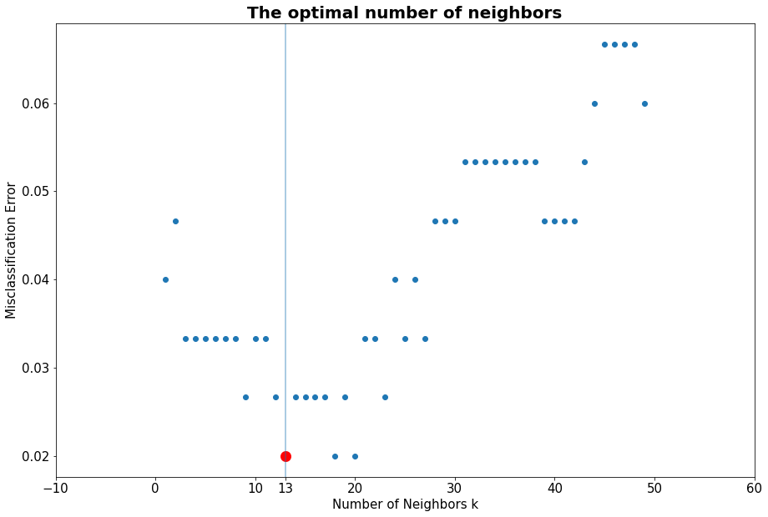
Machine Learning
Algorithms Classification
K-NN (K-Nearest Neighbor)
Universidade Federal do Espírito Santo
Artificial Intelligence Applied to Images
Deep ANNs applied to images

Slide 13
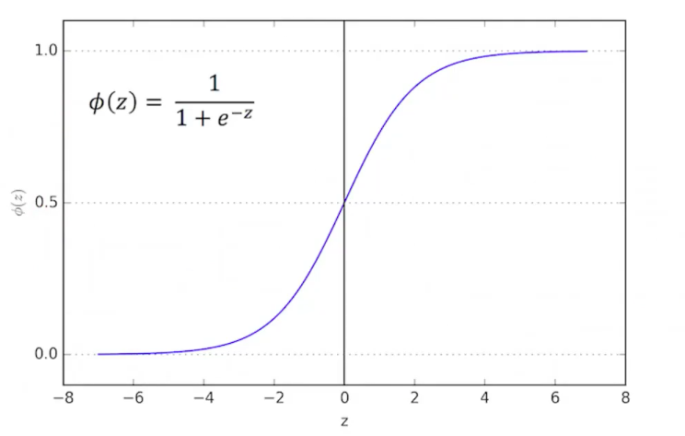
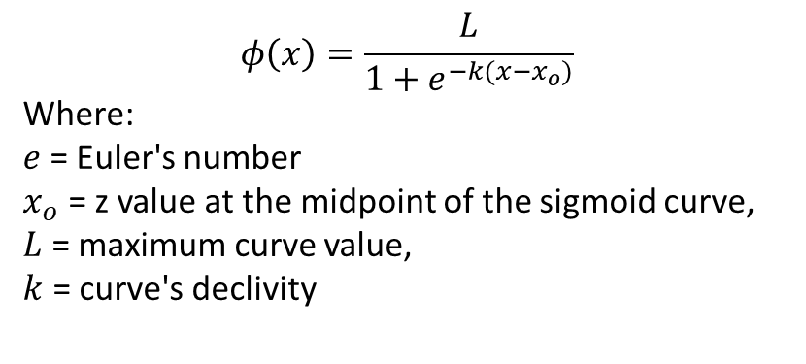



Machine Learning
Algorithms Classification
Logistic Regression
The model uses as link function:
$$φ\left(x\right)=\frac{1}{1+e^{−(x)}}$$
$$φ\left(x\right)=\frac{L}{1+e^{−k(x−x_{o})}}$$
Where:
$e$ = Euler's number
$x_{o}$ = z value at the midpoint of the sigmoid curve,
$L$ = maximum curve value,
$k$ = curve's declivity
(Logistic Function)
$$φ\left(x\right)$$
$$x$$
Universidade Federal do Espírito Santo
Artificial Intelligence Applied to Images
Deep ANNs applied to images

Slide 14
Machine Learning
Algorithms Classification
Logistic Regression
Binary classification
Y
X
Universidade Federal do Espírito Santo
Artificial Intelligence Applied to Images
Deep ANNs applied to images

Slide 15

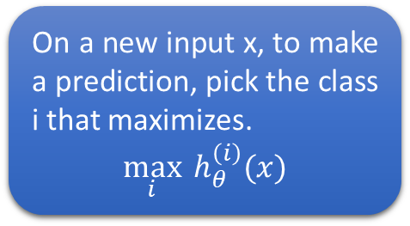

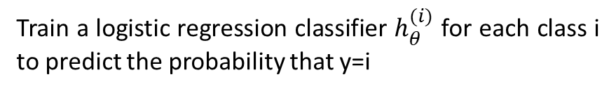


Machine Learning
Algorithms Classification
Logistic Regression
Multi-class classification
Y
Y
On a new input x, to make a prediction, pick the class i that maximizes.
$$\max_{i}{h_{θ}^{\left(i\right)}(x)}$$
$$h_{θ}^{(1)}=P\left(y−\text{0}\text{|}\text{x}\text{;}θ\right)$$
X
Y
X
$$h_{θ}^{(2)}=P\left(y−\text{1}\text{|}\text{x}\text{;}θ\right)$$
Class 0:
Class 1:
Class 2:
X
Y
Train a logistic regression classifier $h_{θ}^{(i)}$ for each class i to predict the probability that y=i
$$h_{θ}^{(3)}=P\left(y−\text{2}\text{|}\text{x}\text{;}θ\right)$$
$$h_{θ}^{(i)}=P\left(y−i\text{|}\text{x}\text{;}θ\right) (i=0, 1, 2, …)$$
X
Universidade Federal do Espírito Santo
Artificial Intelligence Applied to Images
Deep ANNs applied to images

Slide 16
CROSS-VALIDATION
Metrics
Universidade Federal do Espírito Santo
Artificial Intelligence Applied to Images
Deep ANNs applied to images

Slide 17

Cross-validation
Metrics
What’s Cross-validation?
Ability to evaluate the generalizability of a machine learning model from a dataset. Estimate how accurate the model is in practice.
x_train
y_train
x_test
y_test
The hold-out method is good to use when you have a very large dataset, you’re on a time crunch, or you are starting to build an initial model in your data science project. But does not deliver the real potential of the model.
Universidade Federal do Espírito Santo
Artificial Intelligence Applied to Images
Deep ANNs applied to images

Slide 18
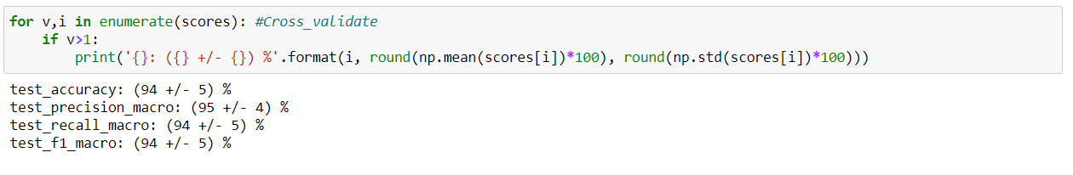
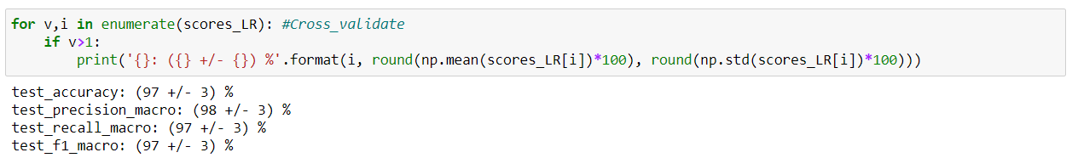
Cross-validation
Metrics
Metrics of cross validate
1. KNN
2. Logistic Regression
Universidade Federal do Espírito Santo
Artificial Intelligence Applied to Images
Deep ANNs applied to images

Slide 19
CONCLUSION
Cross-validation
Universidade Federal do Espírito Santo
Artificial Intelligence Applied to Images
Deep ANNs applied to images

Slide 20
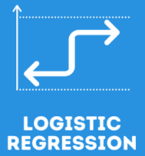

Conclusion
Cross-validation
Best performance
We can see that by applying "Cross Validation" for different metrics. The Logistic Regression algorithm performed better on all scores.
K-NN
Universidade Federal do Espírito Santo
Artificial Intelligence Applied to Images
Deep ANNs applied to images

Slide 21
REFERENCES
Python: Logistic regression and k-Nearest Neighbor algorithms
Matplotlib. Matplotlib: Python plotting — Matplotlib 3.4.2 documentation. Available in: https://matplotlib.org/. Access in: 22 Jul. 2021.
Numpy. NumPy Reference — NumPy v1.21 Manual. Available in: https://numpy.org/doc/stable/reference/. Access in: 22 Jul. 2021.
NumFocus. Pandas. Available in: https://pandas.pydata.org/. Access in: 29 Jul. 2021.
Kaggle. Iris Species. Available in: https://www.kaggle.com/uciml/íris/. Access in: 08 Aug. 2021.
Sktlearn. Nearest Neighbors Classification. Available in: https://scikit-learn.org/stable/modules/neighbors.html#nearest-neighbors-classification. Access in: 08 Aug. 2021.
Sktlearn. LogisticRegression. Available in: https://scikit-learn.org/stable/modules/generated/sklearn.linear_model.LogisticRegression.html?highlight=logistic%20regression#sklearn-linear-model-logisticregression. Access in: 08 Aug. 2021.
Eduardo Destefani Stefanato¹*
Vitor Souza Premoli Pinto de Oliveira¹*
¹Universidade Federal do Espírito Santo
Artificial Intelligence Applied to Images
Universidade Federal do Espírito Santo
Artificial Intelligence Applied to Images
Deep ANNs applied to images

